Slide 1
Laguerre Warped Filters
for Ambisonic Imaging
Joseph Anderson
independent artist
S(PACE) Symposium
Wednesday, 4 May 2011
De Montfort University
Leicester, England

Slide 2
Overview
Introduction
Antecedents (Prior Art)
Ambisonic Encoding
Warped Comb Filters & Resulting Spreading Network
Image Control
Effects
Pros and cons
Summary
Listening & Discussion

Slide 3
Introduction
Goal: synthesize
spatially complex Ambisonic images
How do we generate...
    Complex soundfields?
    Immersive soundfields?
    Active sound fields?
Musically useful?
    Presumably...
    Need “scales” to create
    musical contrasts / meaning
How do we control?
    Less complex
    Less imersive
    Less active

Slide 4
Antecedents
Gerzon “Spreaders”
    Frequency dependent
    Ambisonic panners
    Phase compensated Unitary feedback technique:
    “Difficult”
Menzies
    LAmb
    W-Panning
    (we can ask the man...)

Slide 5
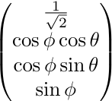
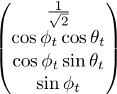
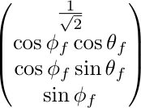
Ambisonic Encoding
Basic 3D...
...as a function of Time...
…as a function of Frequency...

Slide 6

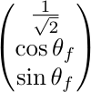
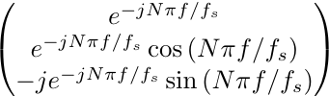
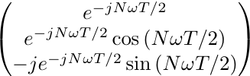
Ambisonic Encoding
Basic 2D...
…as a function of Frequency...
…so need to find 3 filters...

Slide 7
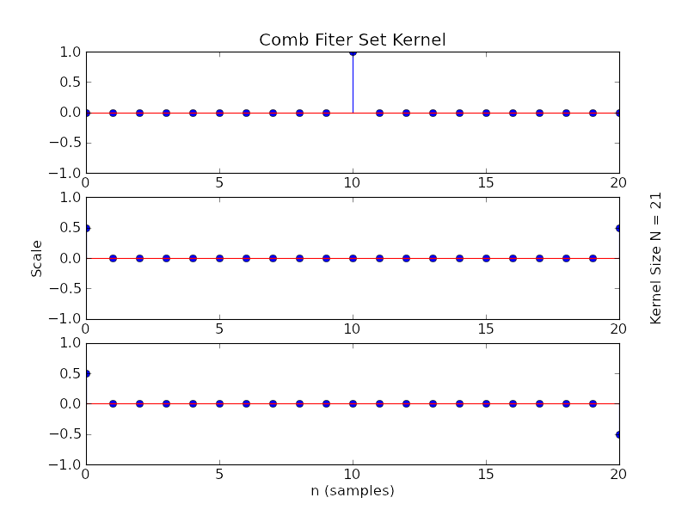
Comb Filter Set
Prototype Filter Kernel

Slide 8
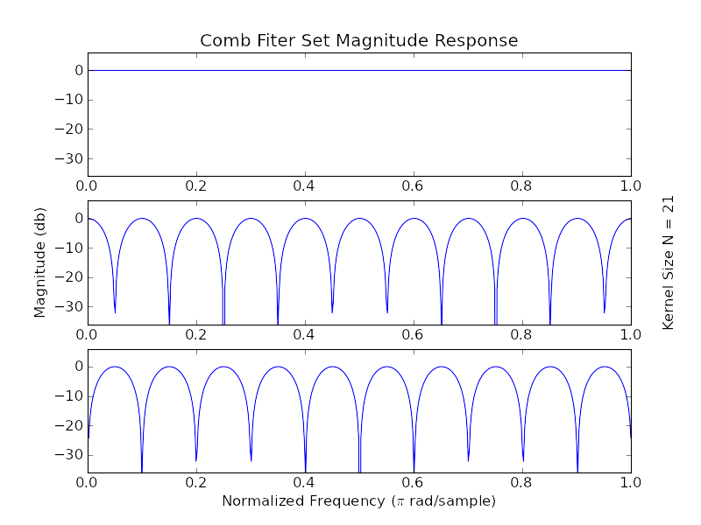
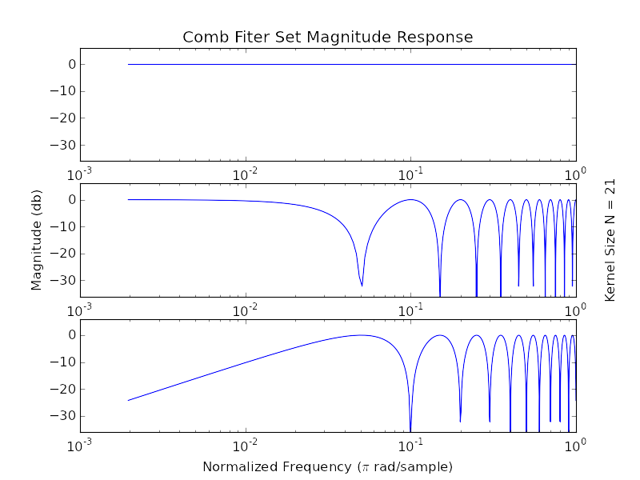
Comb Filter Set
Prototype Magnitude

Slide 9
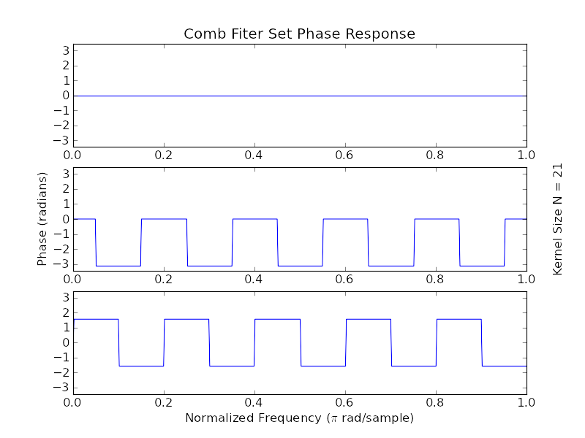
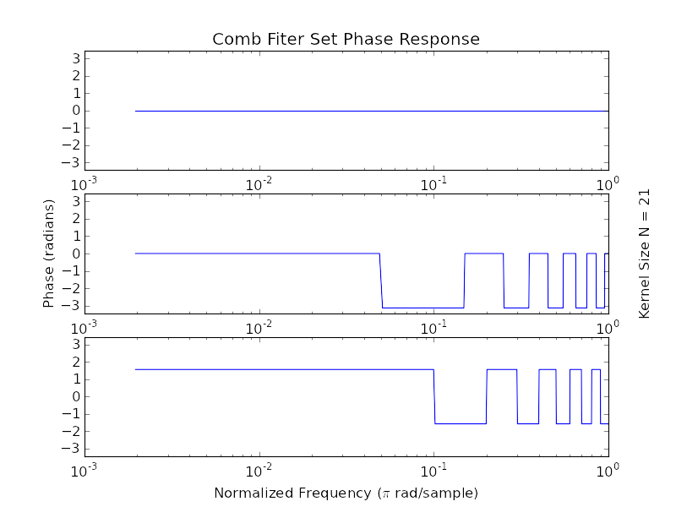
Comb Filter Set
Prototype Phase

Slide 10
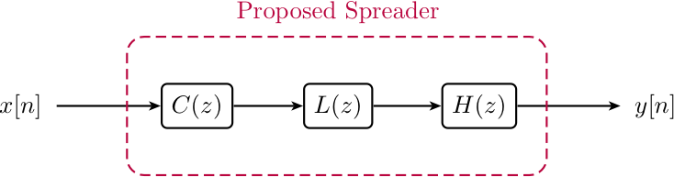
Comb Filter Set
A good start, but...
    Magnitude response is linear rather than logarithmic.
    Sine filter has “nasty” j term,
    i.e., is 90° out of phase.
… luckily we can fix by...
    Frequency warping with the Laguerre Transform
    Phase shifting with the
    Hilbert Transform

Slide 11
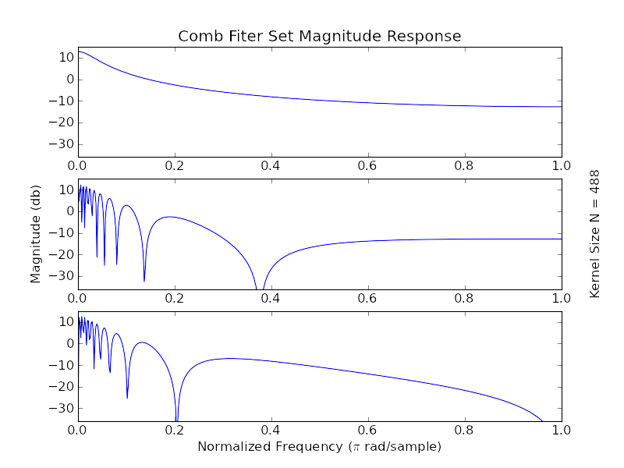
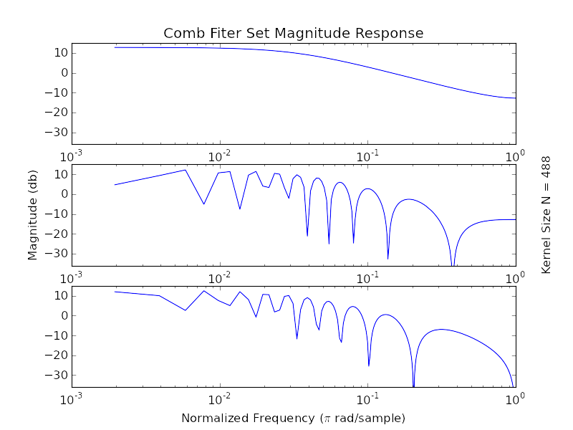
Warped Comb Filter Set
Warped Magnitude
c = .9
No longer all-pass!

Slide 12
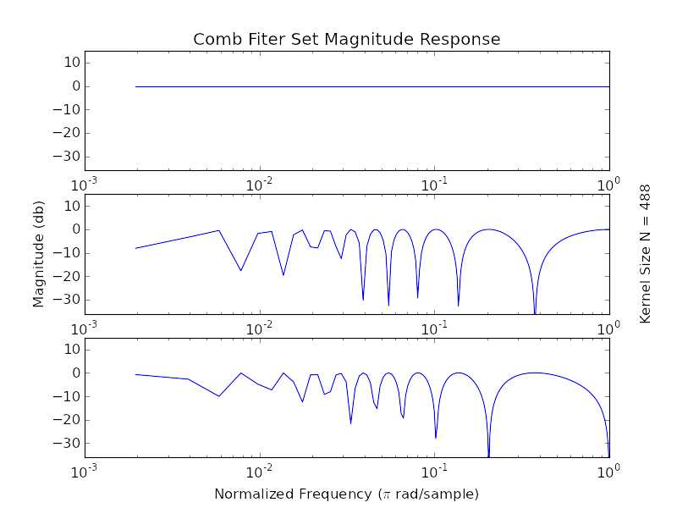
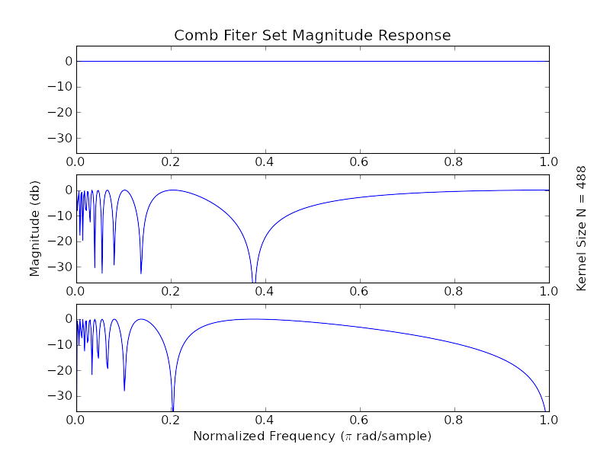

Warped Comb Filter Set
Warped Magnitude, Equalised
c = .9

Slide 13
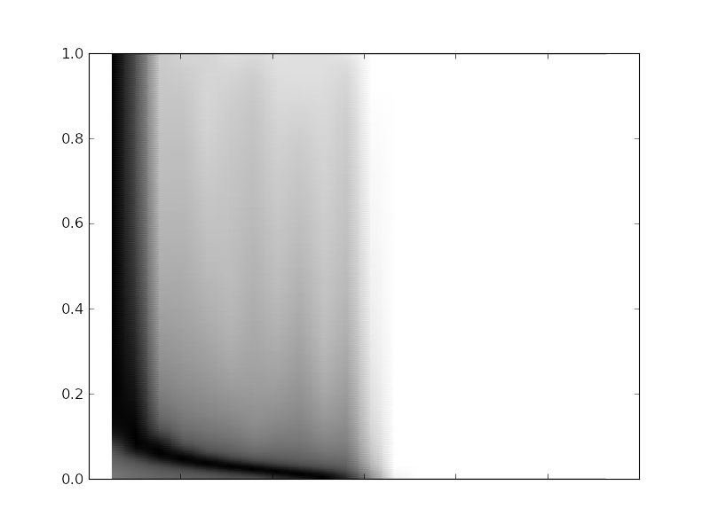
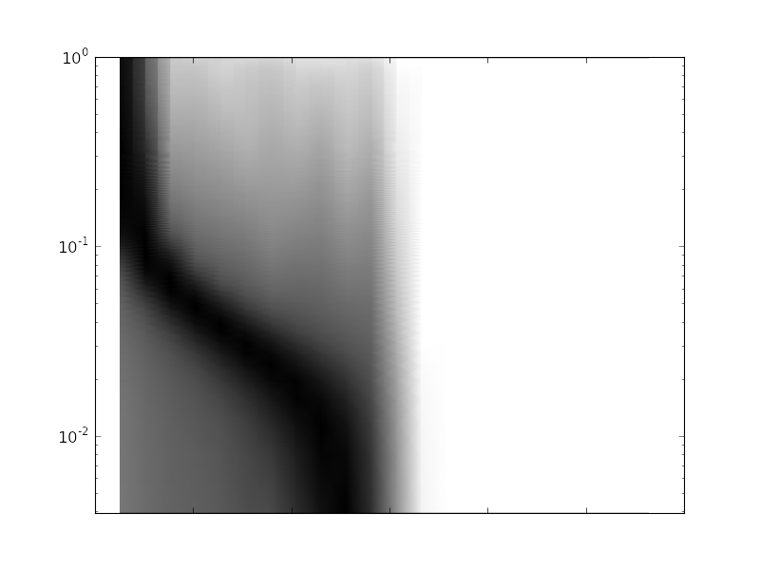
Warped Comb Filter Set
Warped Impulse Response
c = .9
All-pass filter
Time smearing!

Slide 14
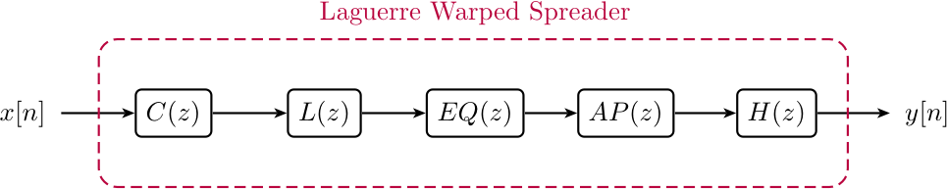
Laguerre Warped Spreader
Components are...
    Comb filter set
    Laguerre Transform
    Equalisation Filter
    All-pass Filter
    Hilbert Transform
… to do...
    Frequency dependent panning
    Distribute panning “evenly”
    Normalise warped response
    Limit time domain warping
    Remove “nasty” j

Slide 15
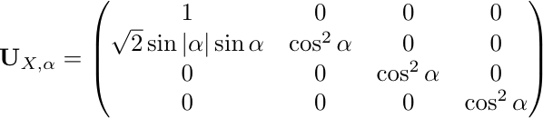
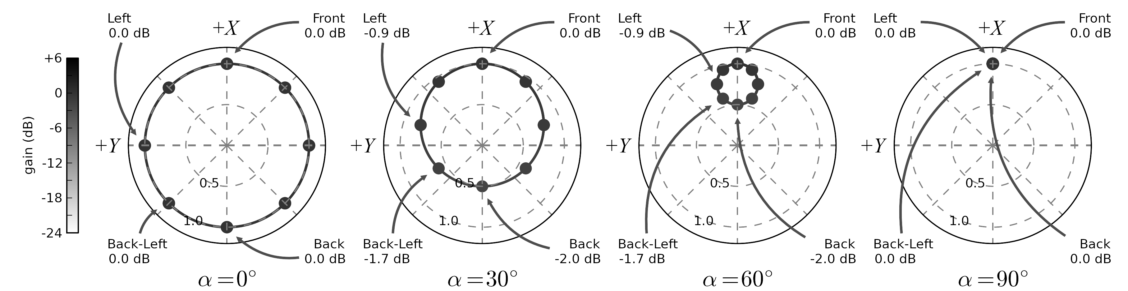
Controlling Resulting Soundfield
Push Transform
    Allows the resulting soundfield to be shaped in space.

Slide 16
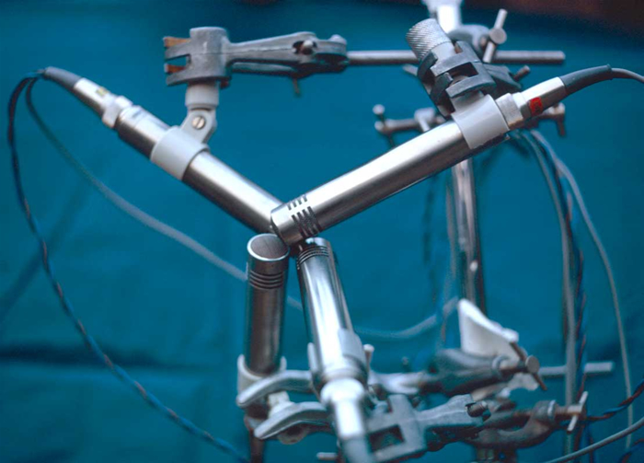
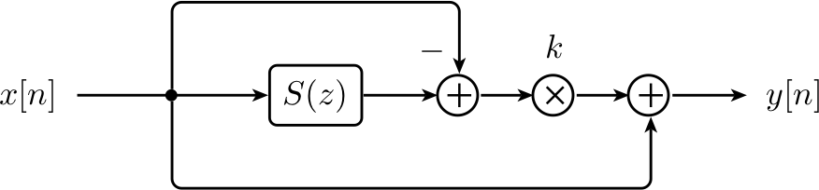
Controlling Resulting Soundfield
Push...
  Two metaphors:
    Re-align Tetrahedron
    Spatial Shelving-Filter
OUTRS tetrahedral microphone array, courtesy Stephen Thornton
(www.michaelgerzonphotos.org.uk)

Slide 17
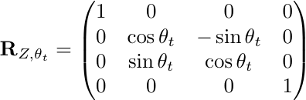
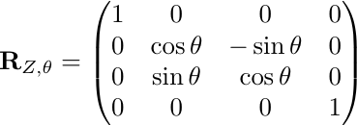
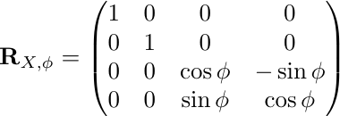
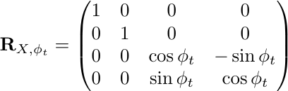
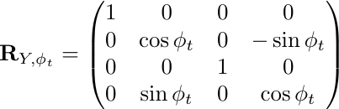
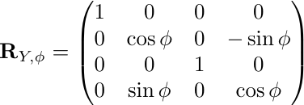
Animating the Soundfield
Rotate
Rotations...
    Modulate in Time...
Tumble
Tilt

Slide 18
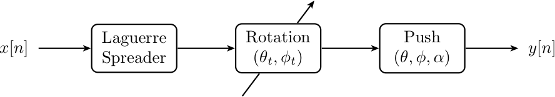
Resulting Network
Hurrah!
Final network
    Image spreading
    Image animation
    Image control

Slide 19
Furthermore...
Class of effects
  Spatial “Barber pole” phasing / flanging
  “Leslie” effects
And...
  Similar tricks with
  Warped All-pass filters!
Hurrah!
!
!

Slide 20
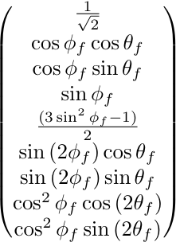
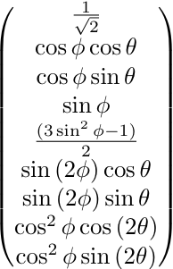
Higher Order Ambisonics
Encoding for 2nd-order Fu-Ma
  Sines and cosines...
Yes, we can do the same trick!

Slide 21
For and against...
Pro
Technique is relatively “easy” to implement & stable
Ambisonic transforms can be made frequency dependent
Various spatial/time domain effects can be created
HOA, easy!
Con
Laguerre warping isn't exactly “equal” in log frequency space
More filter zeros (rotations) = longer filters = more time warping (longer chirps)
FIR implementation only, i.e., IIRs possible, but problems with chirps
Will always have some chirping

Slide 22
Summary
Laguerre Warped Comb Filters
Versatile tools for ergonomic control of soundfields
Numerous Ambisonic transforms can be made frequency dependent using this method

Slide 23
Listening & Discussion

Slide 24
References
[1] Ambisonics Association, “Ambisonic Channels,” Apr-2008. [Online]. Available: http://ambisonics.ch/standards/channels/. [Accessed: 17-Apr-2011].
[2] J. Anderson, Epiphanie Sequence, [Audio CD] SCD28056. London: Sargasso, 2008.
[3] J. Anderson, “Introducing... The Ambisonic Toolkit,” in Proceedings of the Ambisonics Symposium 2009, Graz, 2009.
[4] P. Dutilleux, “Filters, Delays, Modulations and Demodulations: A tutorial,” in Proceedings of the First COST-G6 Workshop on Digital Audio Effects (DAFX98), Barcelona, Spain, 1998.
[5] P. Dutilleux and U. Zölzer, “Delays,” in DAFX: Digital Audio Effects, U. Zölzer, Ed. West Sussex, England: John Wiley & Sons, 2002, pp. 63-74.
[6] G. Evangelista, “The Short-Time Laguerre Transform: a New Method for Real-Time Frequency Warping of Sounds,” in Proceedings of the International Computer Music Conference (ICMC), Berlin, 2000, pp. 380-383.
[7] G. Evangelista, “Time and Frequency Warping Musical Signals,” in DAFX: Digital Audio Effects, U. Zölzer, Ed. West Sussex, England: John Wiley & Sons, 2002, pp. 439-463.
[8] G. Evangelista and S. Cavaliere, “The discrete-time frequency warped wavelet transforms,” in Proceedings of the IEEE International Conference on Acoustics, Speech, and Signal Processing, 1997 (ICASSP-97), Munich , Germany, 1997, vol. 3, pp. 2105 - 2108.
[9] S. Franz, S. K. Mitra, J. C. Schmidt, and G. Doblinger, “Warped Discrete Fourier Transform: A New Concept in Digital Signal Processing,” in Proceedings of the 2002 International Conference on Acoustics, Speech and Signal Processing, Orlando, Florida, 2002, vol. 2, pp. 1205-1208.
[10] R. Furse, “3D Audio Links and Information.” [Online]. Available: http://www.muse.demon.co.uk/3daudio.html. [Accessed: 18-Mar-2011].
[11] M. A. Gerzon, “Periphony: With-Height Sound Reproduction,” Journal of the Audio Engineering Society, vol. 21, no. 1, pp. 2-10, Feb. 1973.
[12] M. A. Gerzon, Artificial Reverberation and Spreader Devices. NRDC, 1975.
[13] M. A. Gerzon, Panpot and Soundfield Controlls. NRDC, 1975.
[14] M. A. Gerzon, “Ambisonics in Multichannel Broadcasting and Video,” Journal of the Audio Engineering Society, vol. 33, no. 11, pp. 859-871, Nov. 1985.
[15] M. A. Gerzon, “Signal Processing for Simulating Realistic Stereo Images,” in Preprint 3423 of the 92nd Audio Engineering Society Convention, San Francisco, 1992.
[16] M. A. Gerzon, “Stereophonic Signal Processor,” U.S. Patent 567128723-Sep-1997.
[17] A. Härmä, M. Karjalainen, L. Savioja, V. Välimäki, U. K. Laine, and J. Huopaniemi, “Frequency-Warped Signal Processing for Audio Applications,” Journal of the Audio Engineering Society, vol. 48, no. 11, pp. 1011-1031, Nov. 2000.
[18] M. Karjalainen, A. Härmä, U. K. Laine, and J. Huopaniemi, “Warped Filters and Their Audio Applications,” in Proceedings of the IEEE Workshop on Applications of Signal Processing to Audio and Acoustics 2001, New Paltz, New York, 1997, p. 4.
[19] A. Makur and S. K. Mitra, “Warped Discrete-Fourier Transform: Theory and Applications,” IEEE Transactions on Circuits and Systems I: Fundamental Theory and Applications, vol. 48, no. 9, pp. 1086 - 1093, Sep. 2001.
[20] D. G. Malham and A. Myatt, “3-D Sound Spatialization using Ambisonic Techniques,” Computer Music Journal, vol. 19, no. 4, pp. 58-70, 1995.
[21] D. Menzies, “LAmb, an Introduction and Tutorial,” in Proceedings of Bourges Synthese, Bourges, France, 1997.
[22] D. Menzies, “W-panning and O-format, tools for object spatialization,” in Proceedings of the Audio Engineering Society 22nd International Conference on Virtual, Synthetic and Entertainment Audio, Espoo, Finland, 2002.
[23] J. O. Smith, “‘Analysis of a Digital Comb Filter’, in Introduction to Digital Filters with Audio Applications,” Analysis of a Digital Comb Filter, Sep-2007. [Online]. Available: https://ccrma.stanford.edu/~jos/fp/Analysis_Digital_Comb_Filter.html. [Accessed: 11-Apr-2011].
[24] S. Thornton, “Tetrahedral Recording Session Images,” Michael Gerzon Audio Pioneer, 2009. [Online]. Available: http://www.michaelgerzonphotos.org.uk/tetrahedral-recording-images.html. [Accessed: 17-Apr-2011].

Slide 25
Thanks!!
josephlloydanderson@mac.com

